Slide 1
Modelling of Cell Polarity by Finite Differences
Group No.1

Slide 2
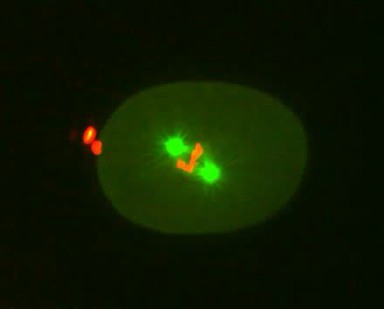
Division of an early C. elegans embryo
Division of an early C. elegans embryo expressing GFP::Tubulin (in green) & mCherry::Histone (in Red)

Slide 3
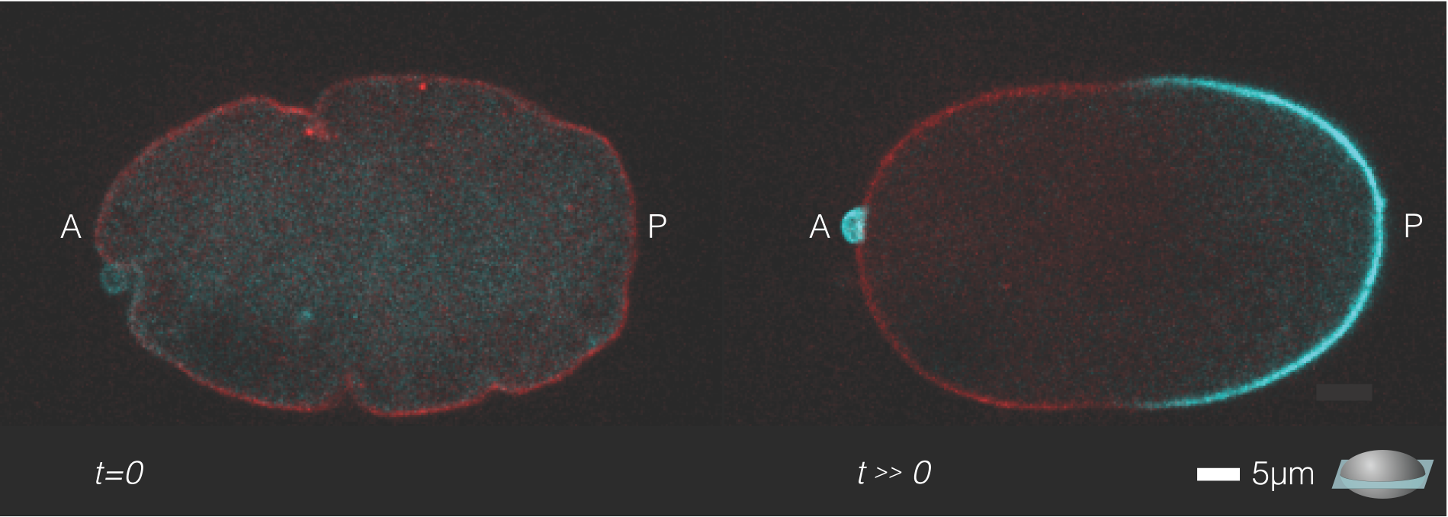
Background & Analysis-Observation
Fig. 2 Fluorescence microscopy image

Slide 5
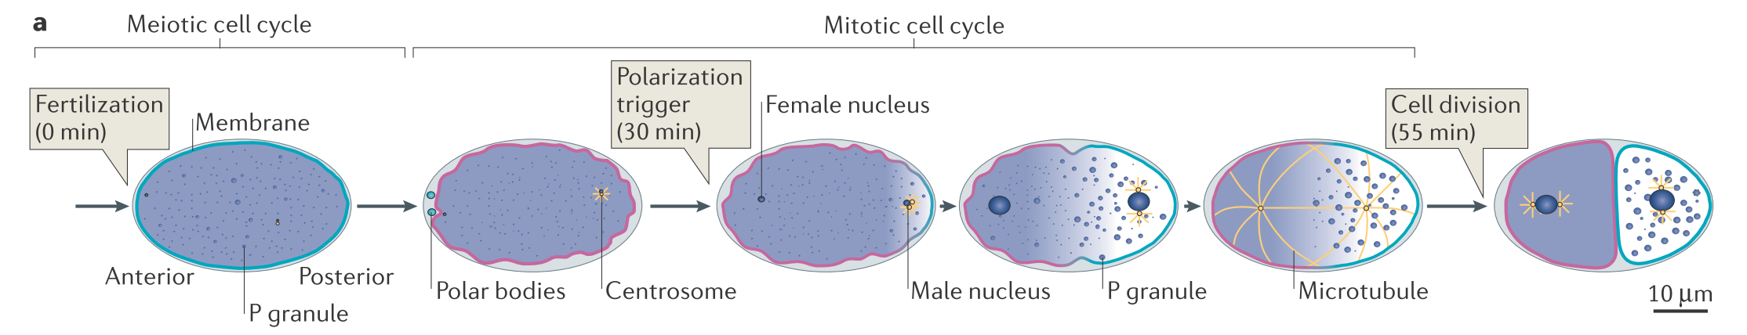
Background & Analysis-Observation
Fig.1 Polarization
Hoege et al., MOLECULAR CELL BIOLOGY 315 14 (2013)

Slide 6
Main Components of the System
Reactions within PAR complexes
Diffusion of PAR complexes from the ctyoplasm to the membrane
Advection of PAR complexes on the membrane

Slide 7
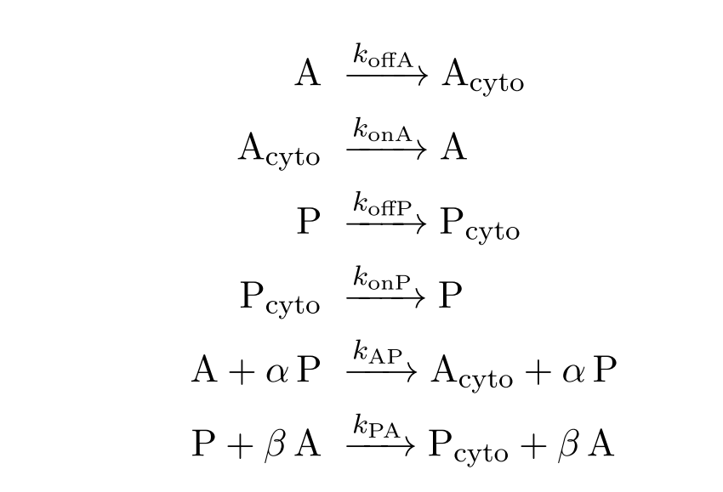
PAR Reaction System

Slide 8
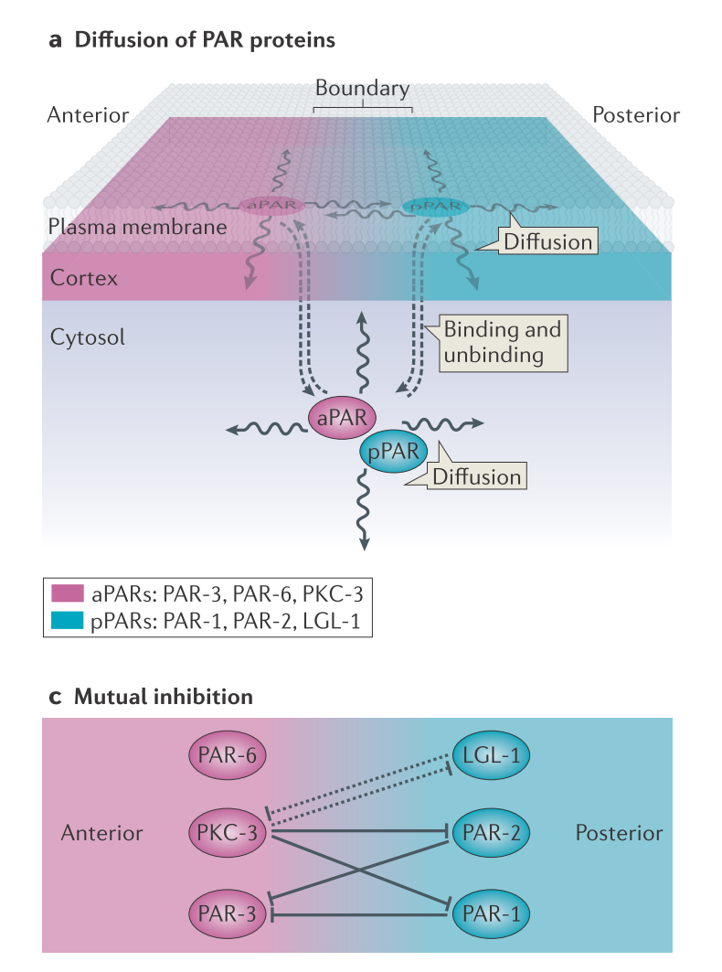
PAR Diffusion
Hoege et al., MOLECULAR CELL BIOLOGY 315 14 (2013)

Slide 9
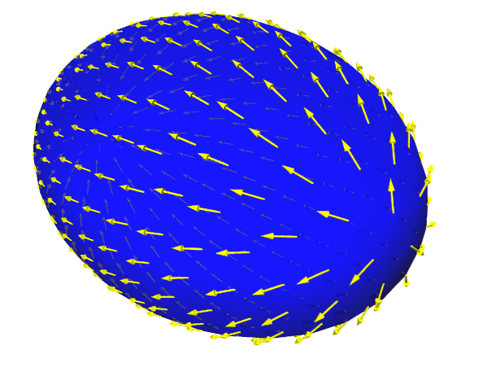
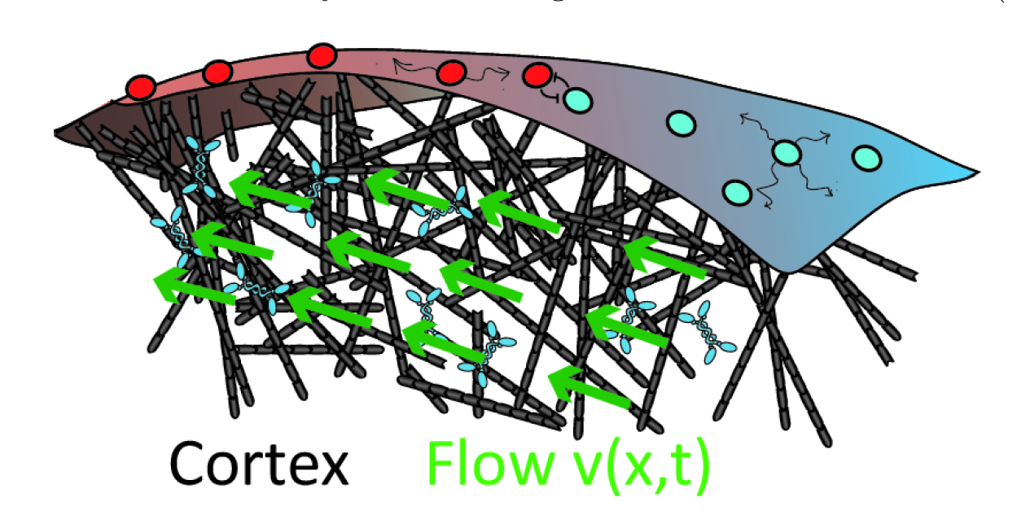
Advection on the Membrane

Slide 10
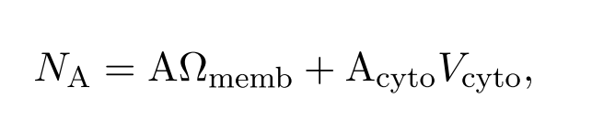
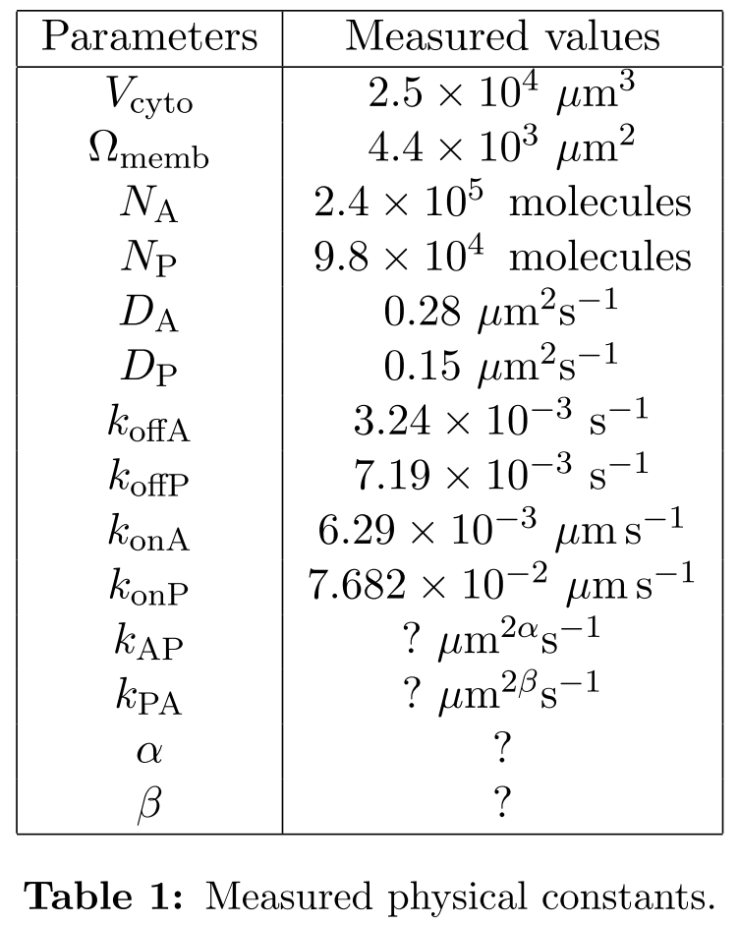
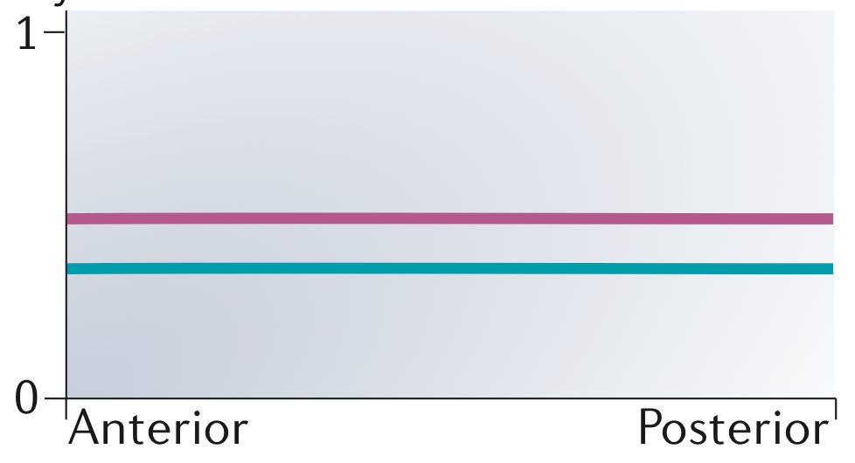
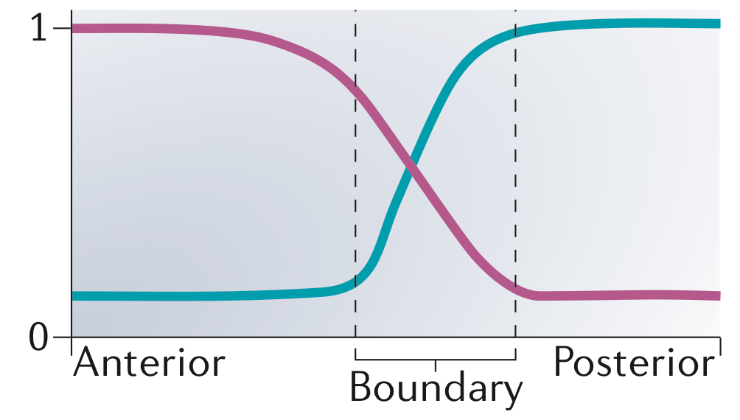
The Conservation Equation
Hoege et al., MOLECULAR CELL BIOLOGY 315 14 (2013)

Slide 11
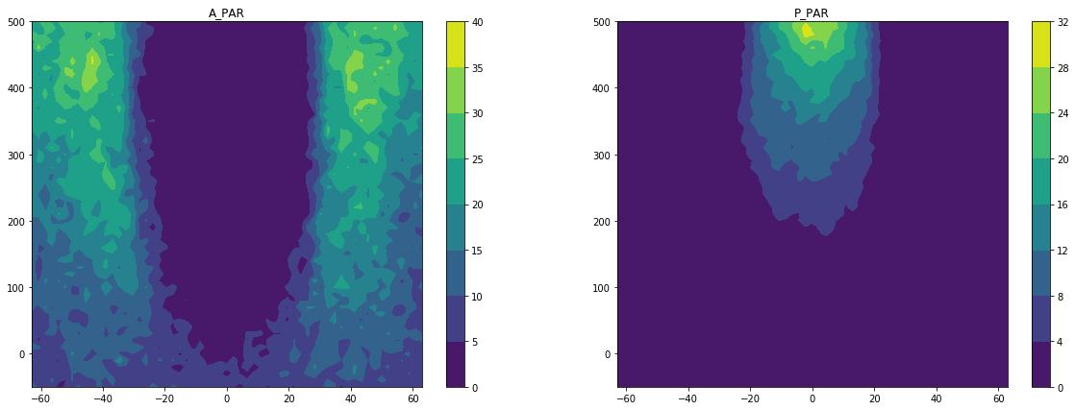
Concentration of PARs on Spacetime
Concentration
Concentration
Time
Time
Anterior Posterior Anterior
SPACE
Anterior Posterior Anterior
SPACE

Slide 12
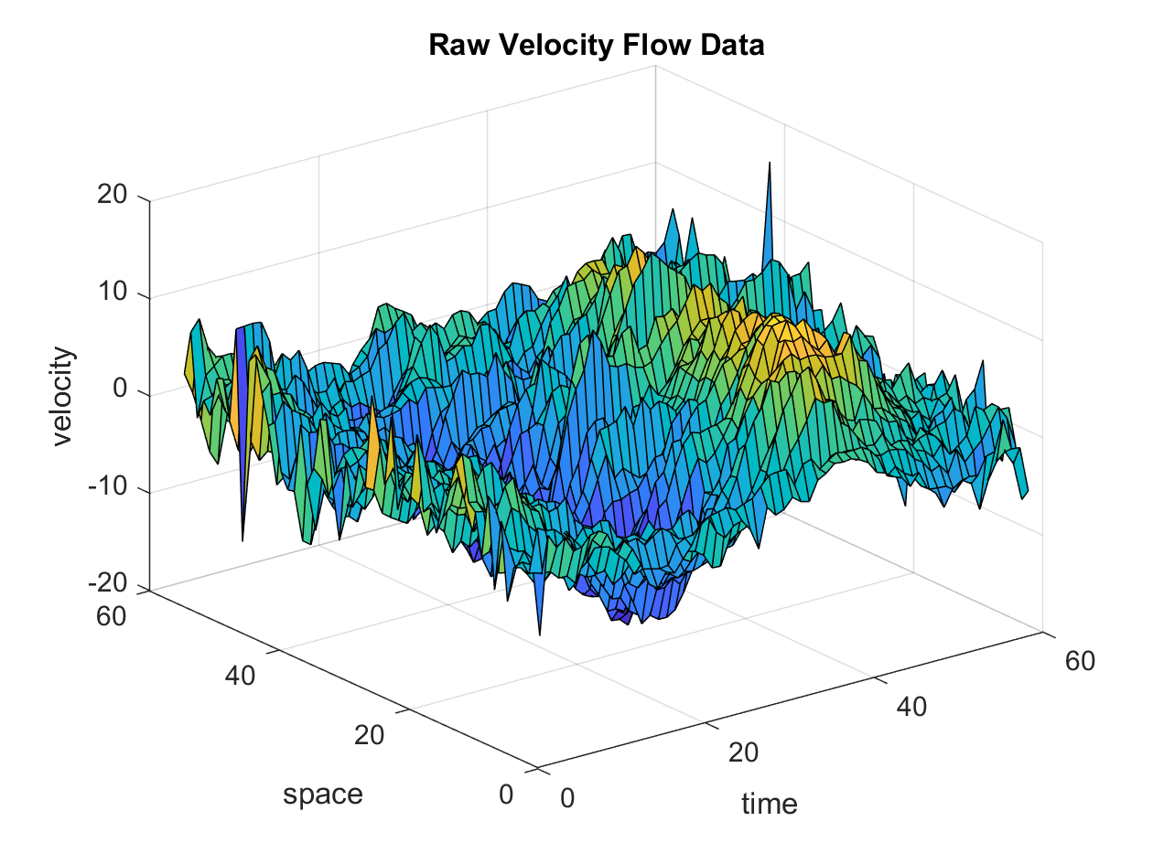
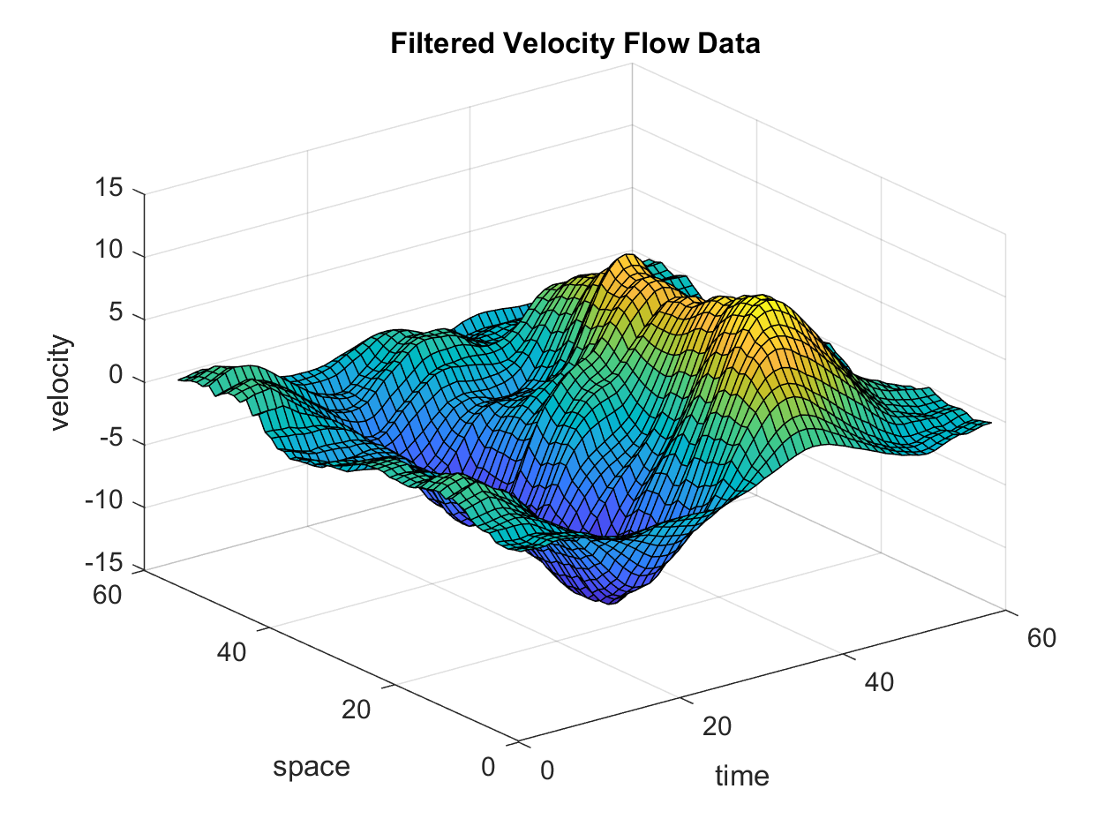
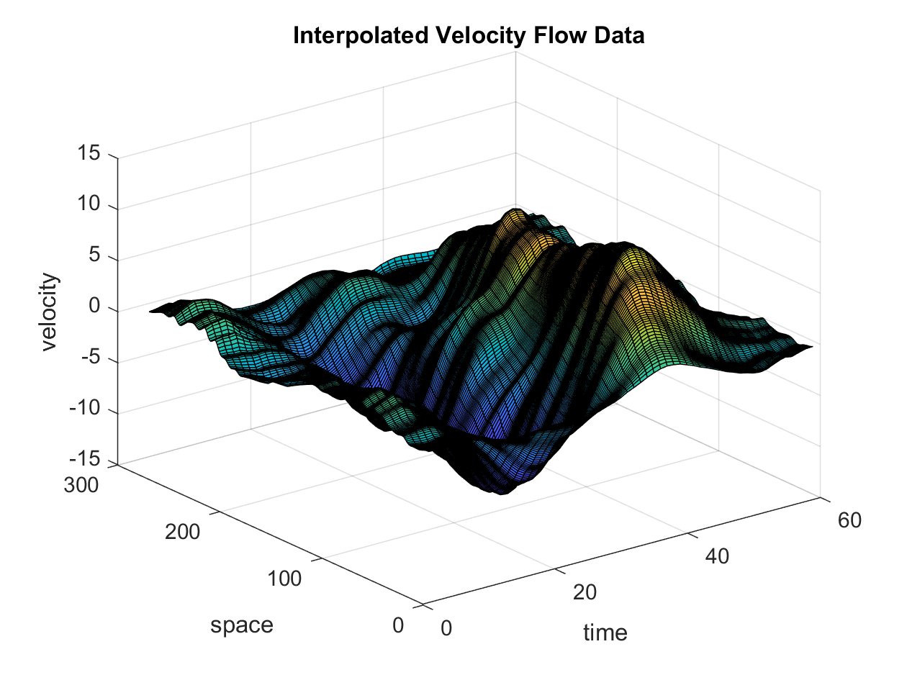
Velocity Flow of the Membrane
Low pass Filtering by
Convolution
Polynomial
Interpolation

Slide 13
Velocity Flow of the Membrane
Low pass Filtering by
Convolution
Polynomial
Interpolation
RESPECTING CFL v * dt < dx

Slide 14
Modeling Approach Evaluation
Number of PAR proteins is high: Na = 2,4*10⁵, Np = 9,8*10⁴
Agent-Based Simulations may be computationally too expensive
The stochastic behaviour is negligible
DISCRETIZATION BY FINITE DIFFERENCES LAX-FRIEDRICH SCHEME

Slide 15
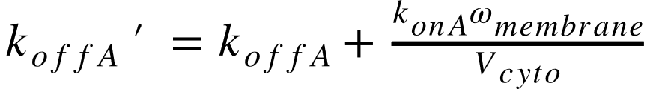
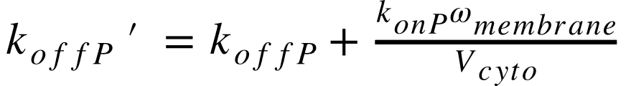
Discretization By Finite Differences L-F

Slide 16
Discretization By Finite Differences L-F
Reaction
Diffusion
Advection
α=2
β=2
KAP = ? KPA = ?

Slide 17
Discretization By Finite Differences L-F
)

Slide 18
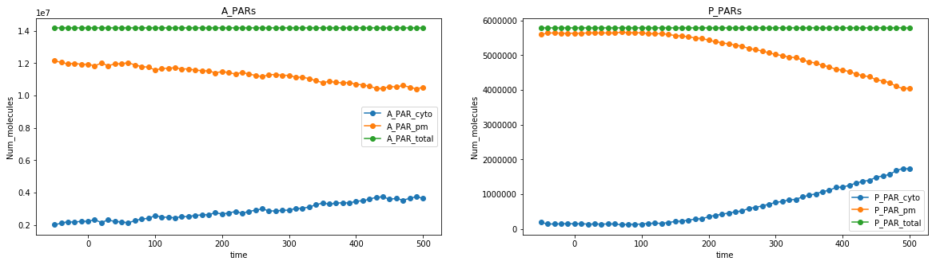
Fitting Kap Kpa
Find values of the reaction rates Kap and Kpa that, once plugged into the difference equations, fits the changing in concentration of the PAR complex on membrane and cytosol.
LEAST SQUARE CURVE FITTING using Trust Region Reflective algorithm

Slide 19
Evaluating Consistency in Space
Checking wether the estimated values of Kap and Kpa could match the spatial profile given by the experimental data.

Slide 20
Unfortunately…..

Slide 21
Unfortunately…..
SHIT HAPPENS

Slide 22
But…

Slide 23
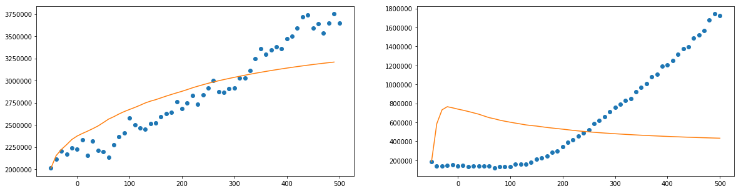
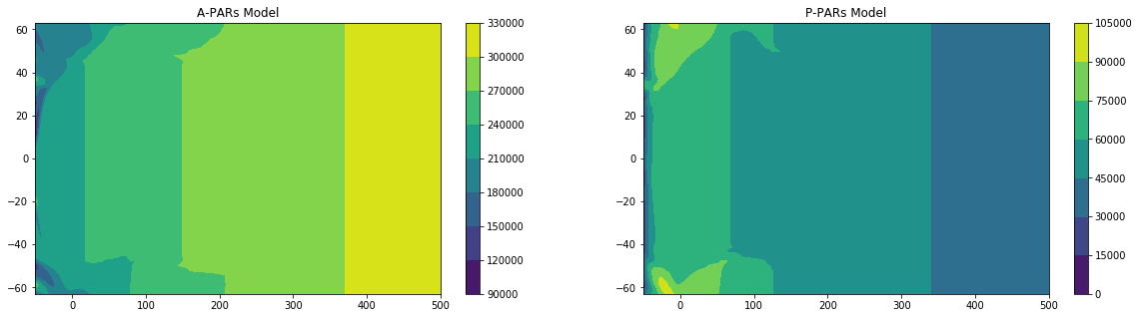
Last Minute Results

Slide 24
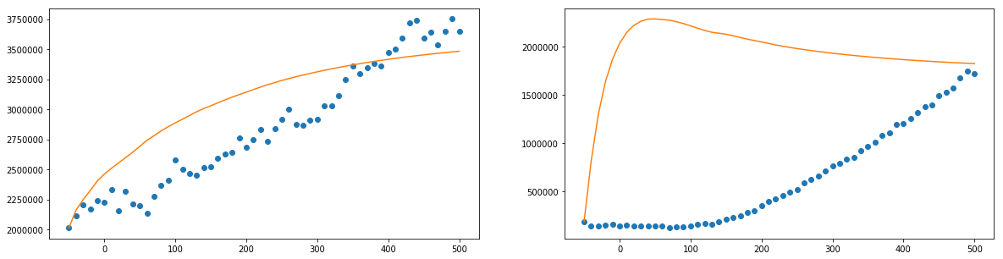
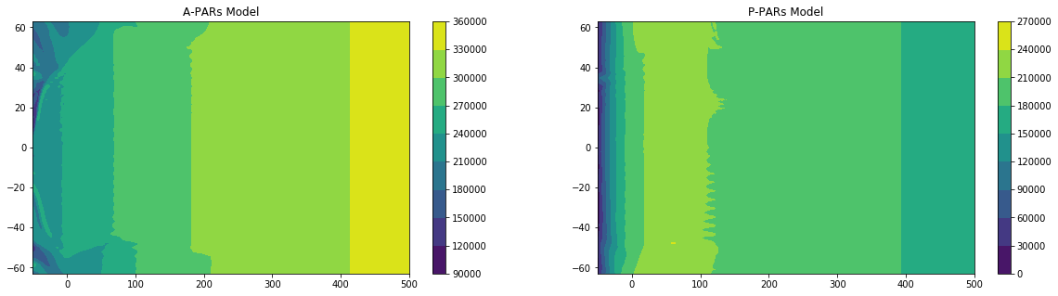
Last Second Result

